Slide 1
Assessing Diurnal/Diel Emissions with TEMPO
Randall Martin and panelists

Slide 2

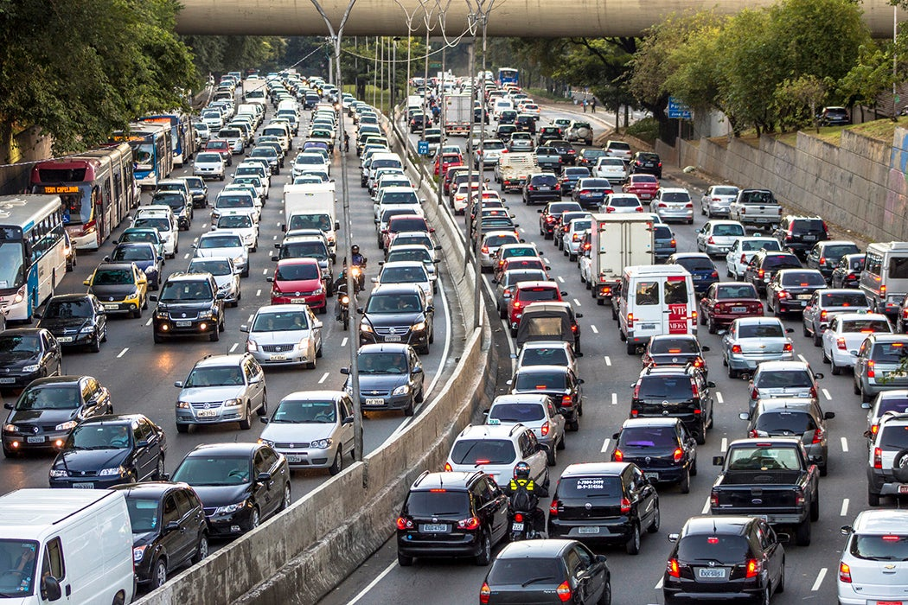
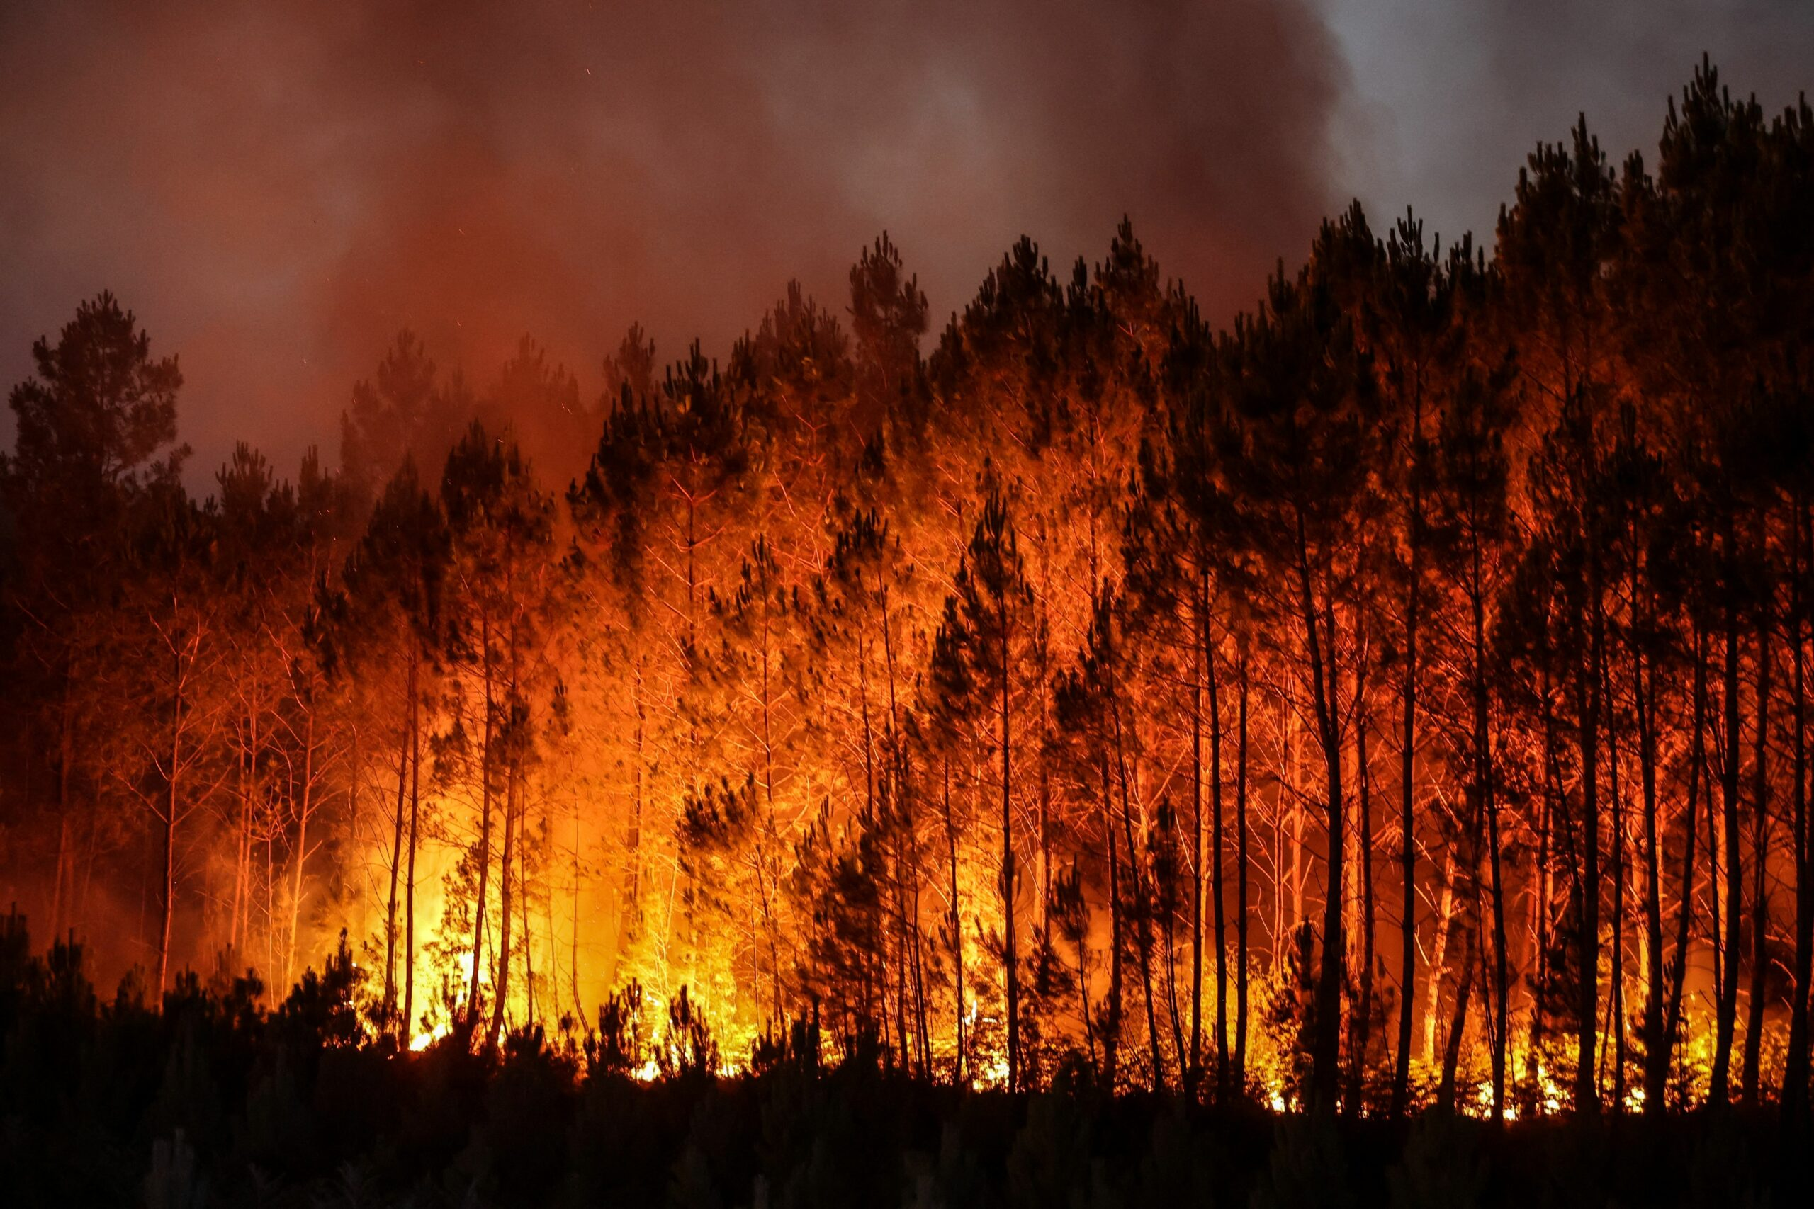
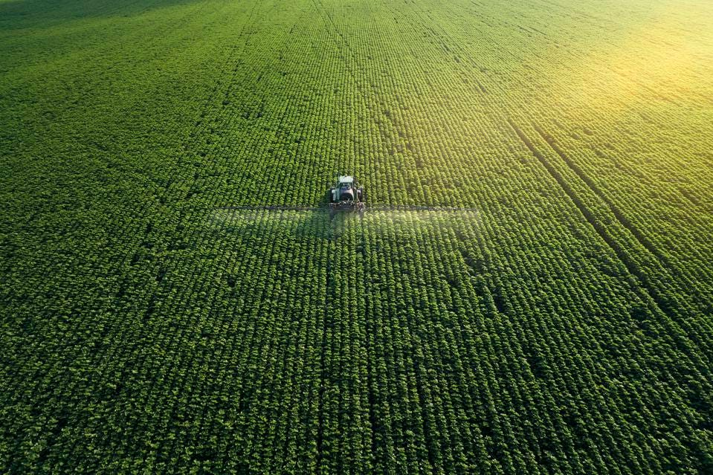
Opportunities: Rapidly Changing Activity Patterns and Emissions

Slide 3


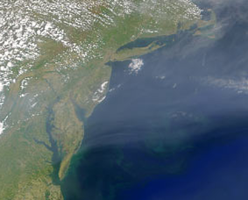
Challenges: Within-day Variability at Fine Resolution
Accounting for and exploiting fine resolution
Representing within-day variation in other atmospheric and surface processes
Within-day variation in trace gas profile (changes rapidly in morning)
Altitude
Concentration

Slide 4
Discussion Questions
What are the opportunities offered by TEMPO measurements to improve the quantification of emissions? Which emissions?
What challenges need to be addressed to exploit TEMPO observations?
What activities should be prioritized to advance intraday emission quantification using TEMPO measurements?
What differences in techniques are needed for slowly changing emissions versus episodic emissions?

Slide 5
Perspectives from Discussion Panelists
Brian McDonald (NOAA)
Ken Pickering (U Maryland, virtual)
Xiaomeng Jin (Rutgers, virtual)
Ralph Kahn (NASA)
Daniel Tong (George Mason U, virtual)
Fangjun Li (South Dakota State, virtual)
Barron Henderson (EPA)
Targeted discussion of key questions
General discussion

Slide 6
Brian McDonald
NOAA

Slide 7
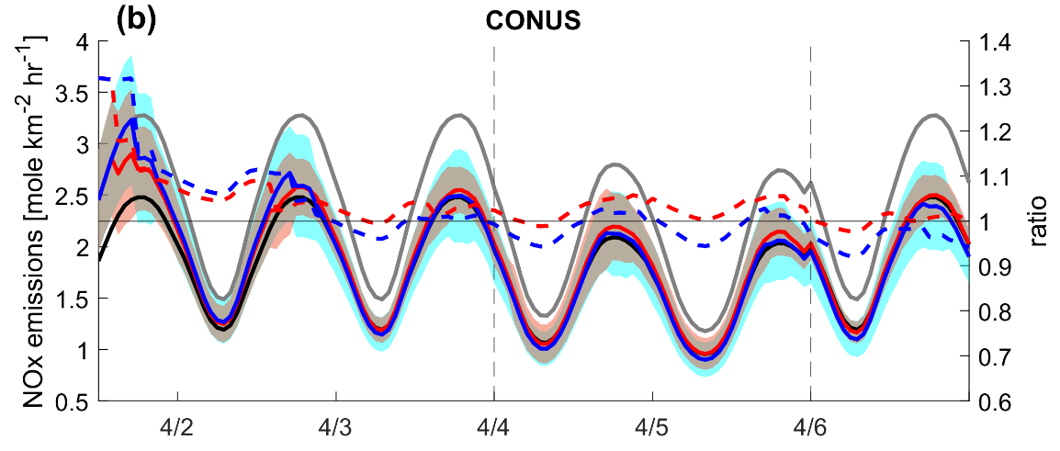

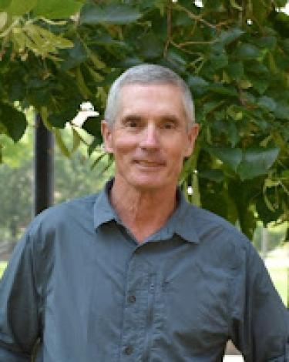
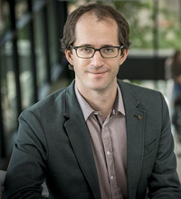
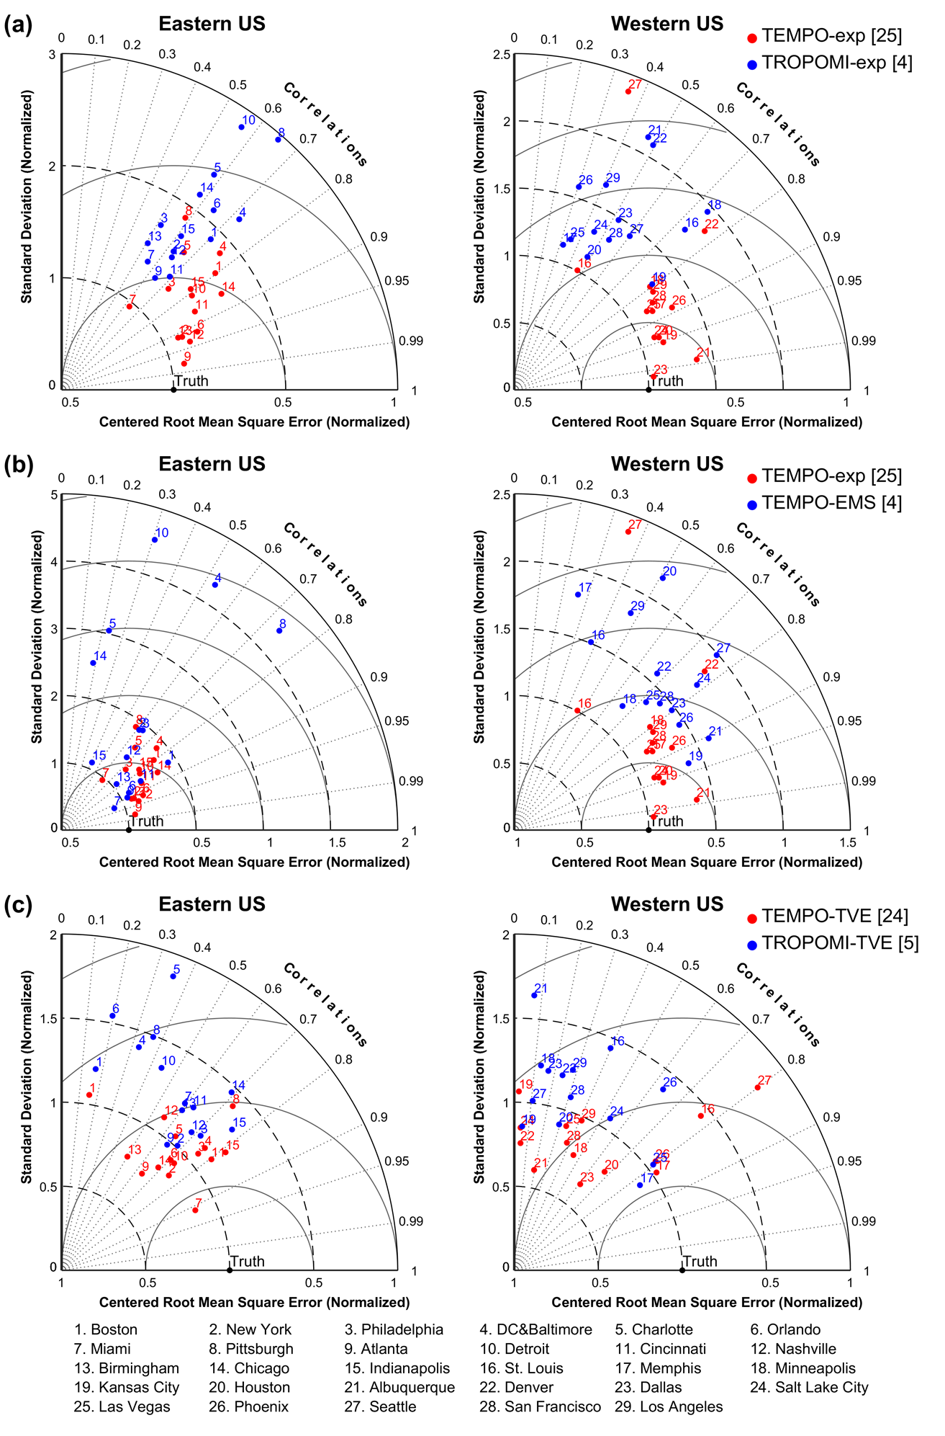
Benefit of Assimilating TEMPO versus TROPOMI NO₂
TEMPO recovers the true emissions at least twice as fast as TROPOMI
Chia-Hua Hsu
(NOAA/CU)
Arthur Mizzi
(NASA Ames)
Daven Henze
(CU)
TEMPO-exp provides more accurate NO_{x} emissions estimates in most cities and regions

Slide 8
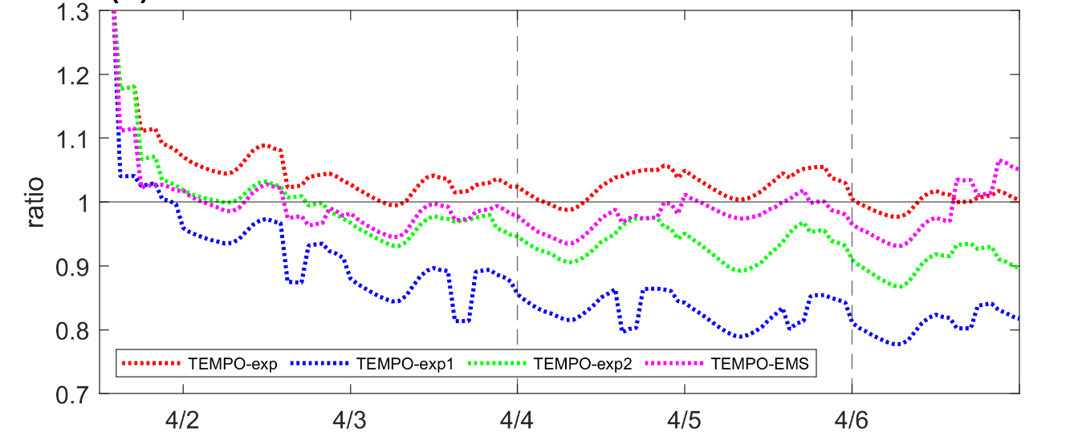
Challenges with Data Assimilation with TEMPO Obs.
no
window
±1.5 h
all cycles
±1.5 h
18 & 21 UTC
only
no
window

Slide 9
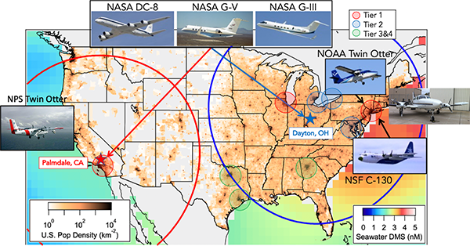


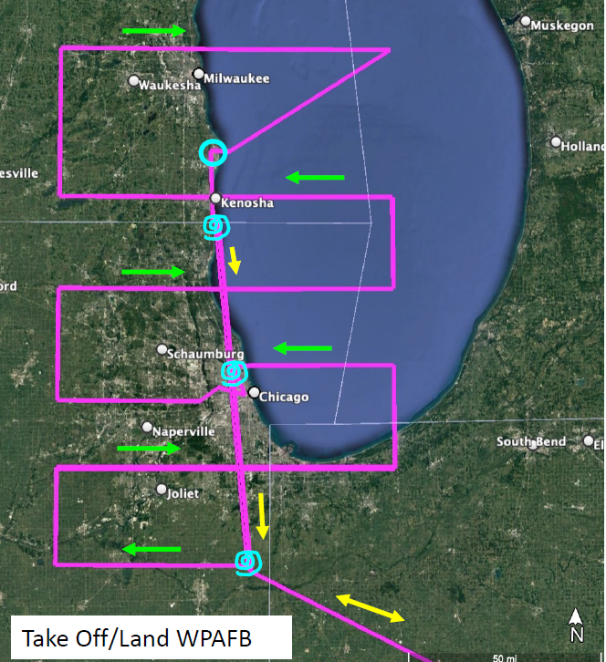

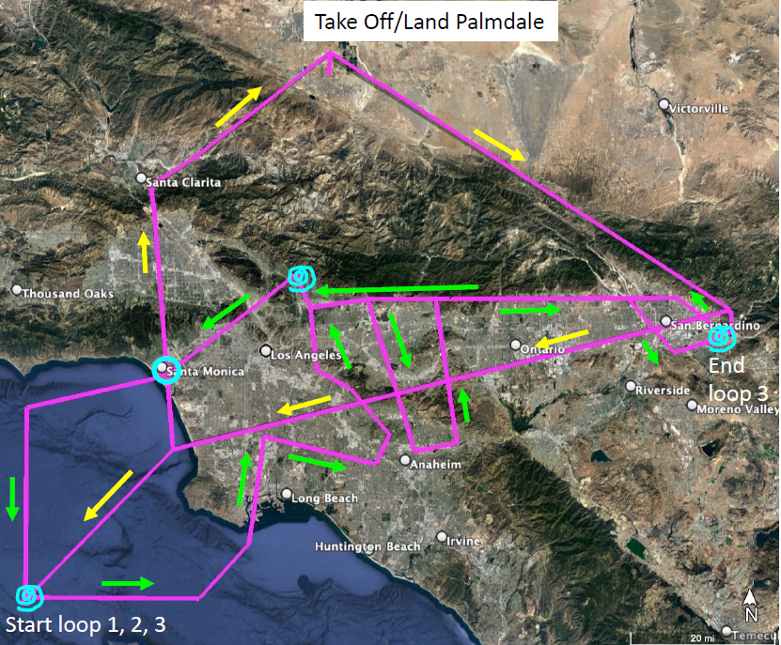
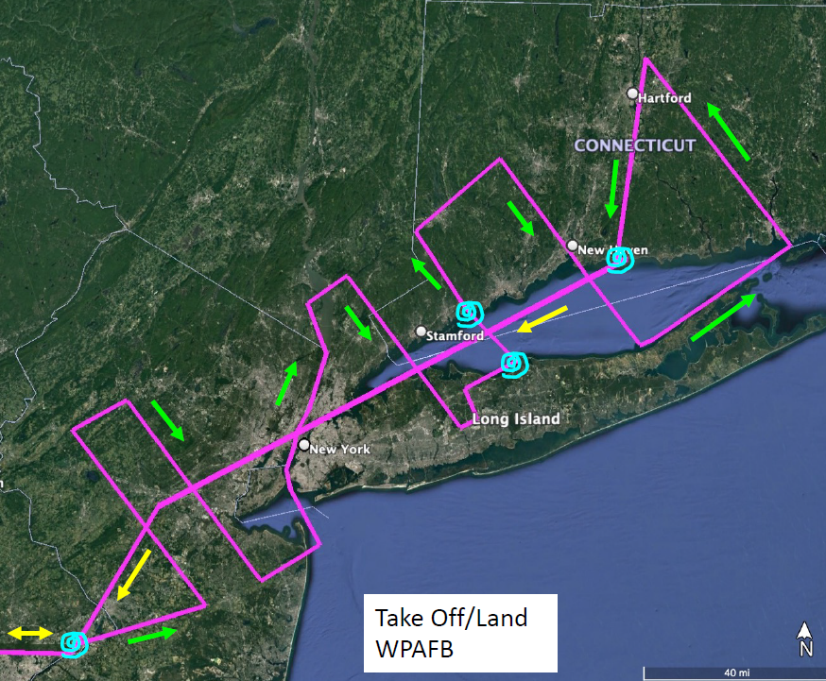
More Field Observations under TEMPO to Evaluate Satellite and Models Diurnally (AEROMMA-STAQS)
Carsten
Warneke
(NOAA CSL)
Rebecca Schwantes
(NOAA CSL)
Laura Judd
(NASA LaRC)

Slide 10
Assessing Diurnal Emissions with TEMPO
Panel Talk
Ken Pickering
University of Maryland

Slide 11
Diurnal Variation of Emissions for Air Quality Modeling
Air quality models (e.g., CMAQ, CAMx, etc.) require emissions to be distributed realistically by hour of the day. EPA SMOKE-MOVES software contains diurnal emission profiles for various source types. How accurate are they?
Can TEMPO data be used to evaluate and improve these diurnal emission distributions?
- Hourly tropospheric columns of NO₂ will be available each day during daylight hours at 2 x 4.75 km spatial resolution
- Should enable estimates of emission variation for major sources, major roadways, area sources
Small EGUs
Prescribed
Fires
Airports
Onroad Vehicles
Examples of diurnal NO_{x} emission profiles
from SMOKE-MOVES

Slide 12
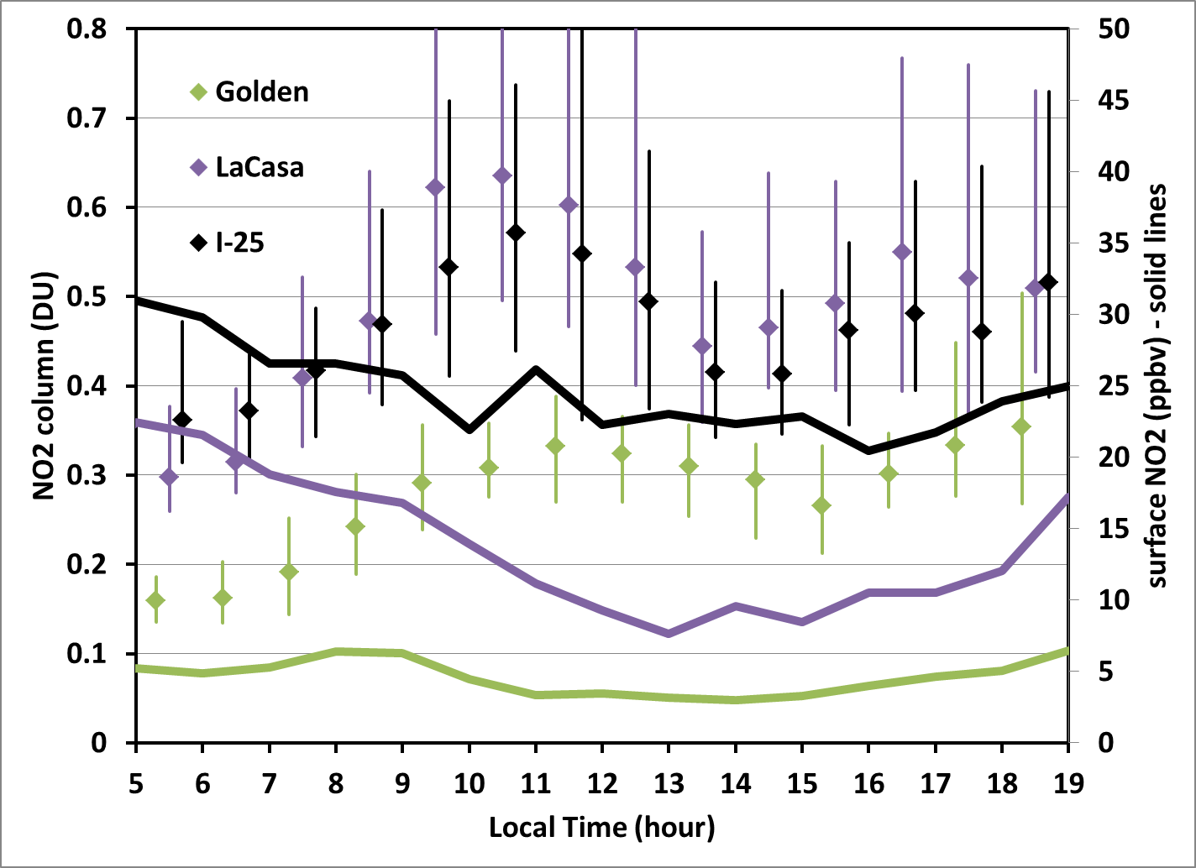
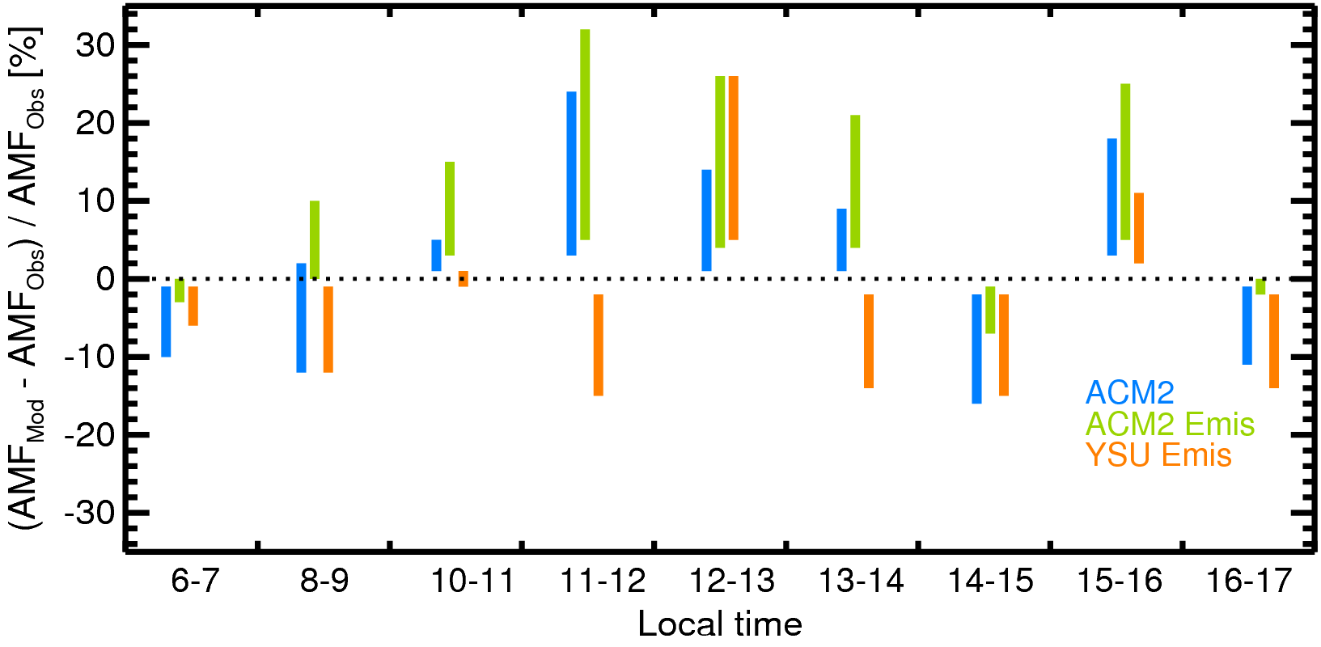
Issues with Use of Tropospheric Columns in Estimating Emissions
DISCOVER-AQ
Colorado
Ranges displayed result from variation of
surface reflectivity, solar zenith angle,
and aerosol optical depth
Lok Lamsal
Jim Crawford
DISCOVER-AQ data often showed surface
and column NO₂ not well correlated. Vertical
mixing rate throughout the morning may
exceed emission rate, allowing columns to
increase, but surface NO₂ to decrease.
Column increases should reflect magnitude
of emissions.
Challenge for TEMPO:
NO₂ tropospheric column retrievals are highly sensitive to
diurnal variation in model-derived a-priori profile shapes.
Model vertical mixing scheme plays a large role in determining
profile shapes.

Slide 13
Free Tropospheric NO₂ Complicates Satellite Emission Estimates
As anthropogenic NOx emissions have declined substantially over North America in the last 20 years, the fraction of the tropospheric column NO₂ due to these emissions has also decreased, causing greater uncertainty in linking surface emissions to satellite-derived NO₂ columns.
The need for accurate information on free tropospheric sources of NO₂ (lightning, aviation, elevated wildfire plumes, aerosol nitrate photolysis) has therefore increased in importance (Silvern et al., 2019; Qu et al., 2021; Shah et al., 2023; Dang et al., 2023)
Wildfire contribution episodic, but has increased in the last decade; aviation contribution varies with economy
Lightning contribution: both diurnal variation and episodic occurrence; global long-term variation very small except 2020
Diurnal Variation of Lightning Flashes
Beirle et al, 2014
Füllekrug et al. (2022)
OMI, TROPOMI, GCAS NO₂ data have been used in estimates of lightning NO_{x} production per flash (Pickering et al., 2016;
Bucsela et al., 2019, Allen et al., 2019; Allen et al., 2021a; Allen et al., 2021b).
TEMPO “Green Paper” Lightning NO_{x} Experiment in Summer 2023 – high time and spatial resolution; will reduce uncertainties
such as NO_{x} lifetime in near field of convection; background NO₂; diurnal variation of UT NO₂

Slide 14
Direct estimates of biomass burning NO_{x} emissions from satellite observations
Xiaomeng Jin
Rutgers University

Slide 15
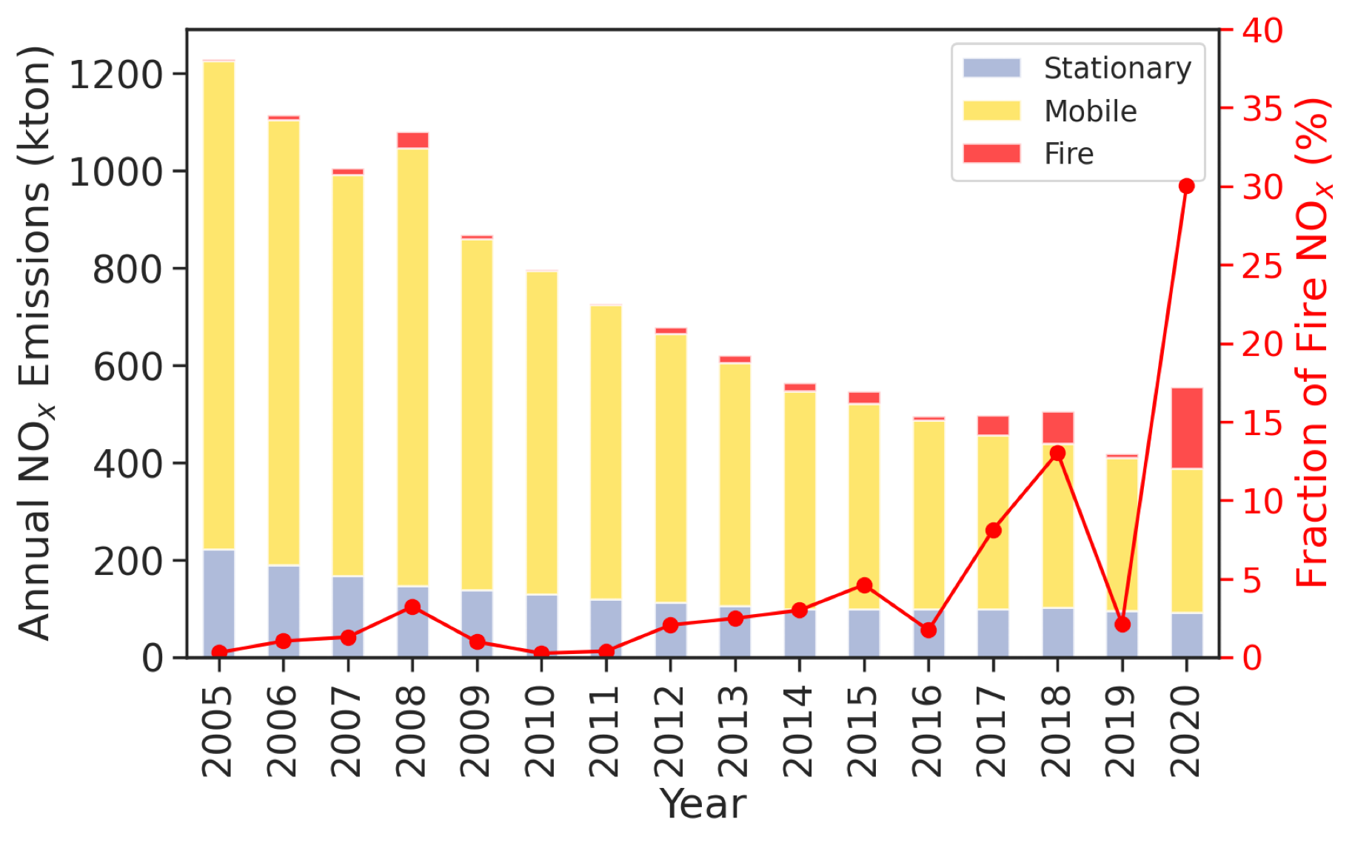
The increasing importance of wildfires to NO_{x} emissions in California
Jin et al., in prep

Slide 16
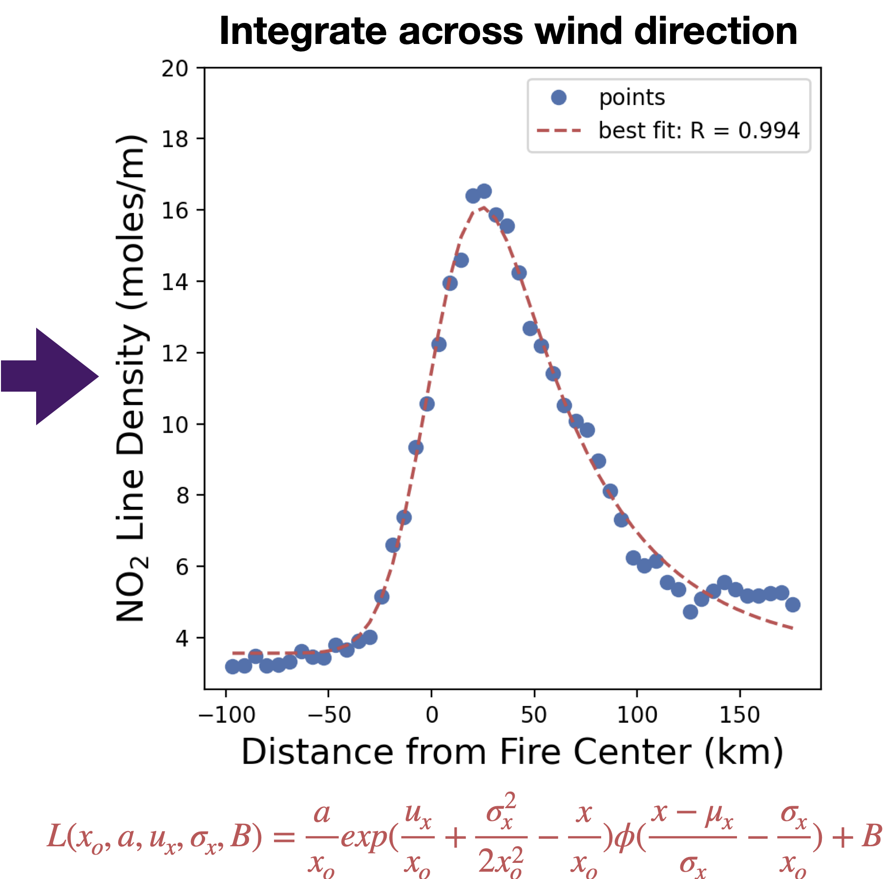
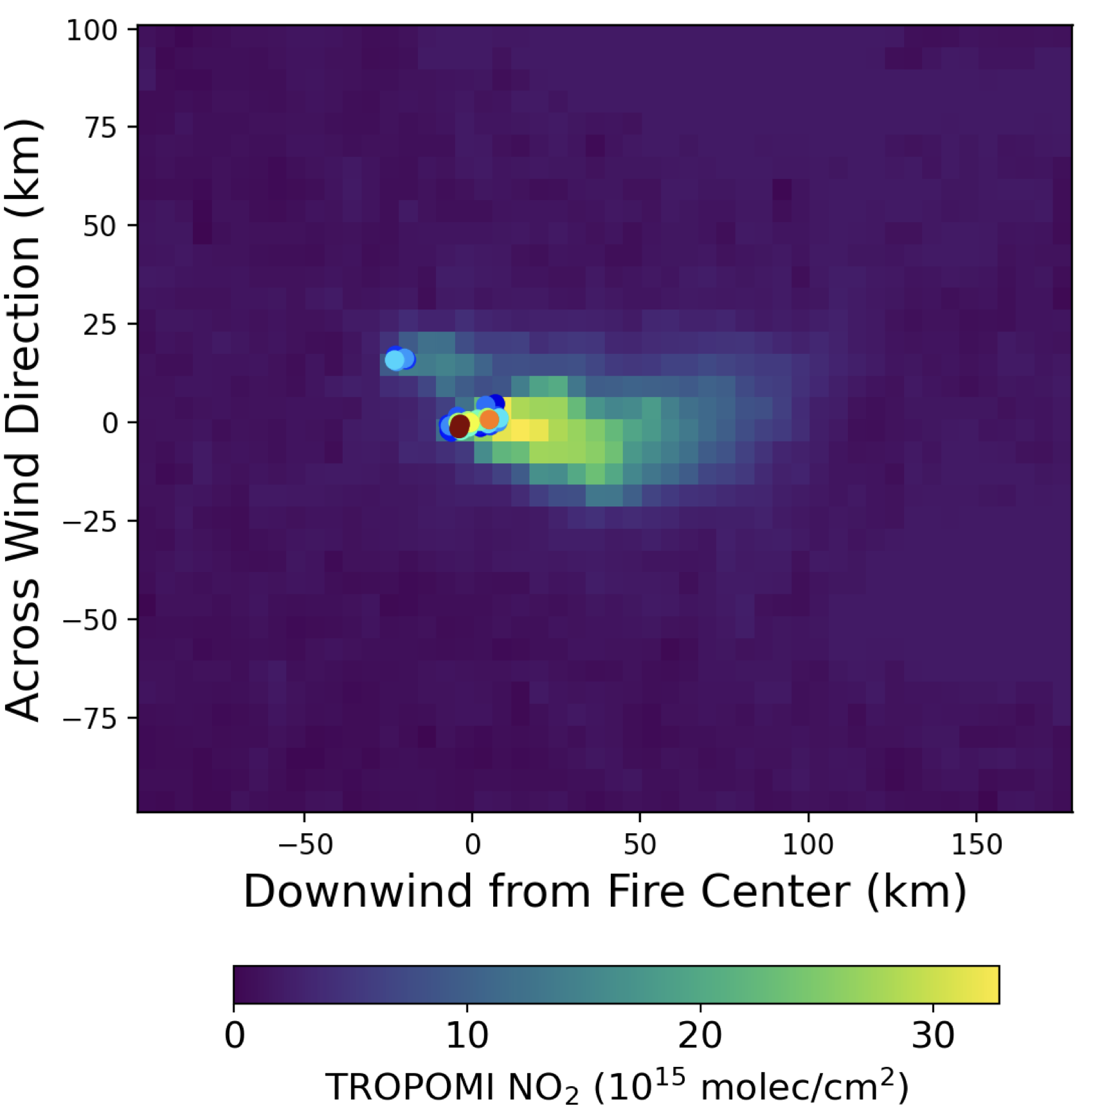
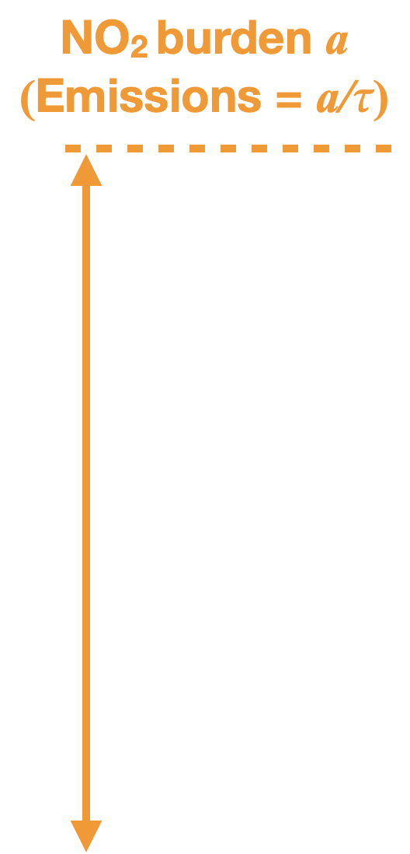
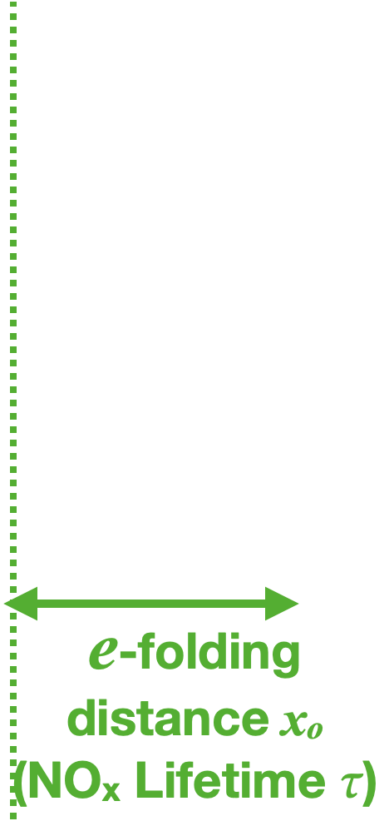
Direct estimates of NO_{x} emissions and lifetimes from daily TROPOMI observations
Rotated TROPOMI NO₂ along wind direction
Jin et al., 2021

Slide 17
TEMPO offers continuous observations of fire plumes: Opportunities and Challenges
Opportunities:
Emission changes with fire progression.
Evolution of reactive nitrogen from fires.
More fires will be detectable from space.
Challenges:
Optimal observational frequency for fast-changing processes.
Uncertainties of satellite retrievals (effects of smoke aerosol, injection height, cloud).
How should we use satellite NO₂ to improve biomass burning emission inventories?

Slide 18
Ralph Kahn
NASA

Slide 19
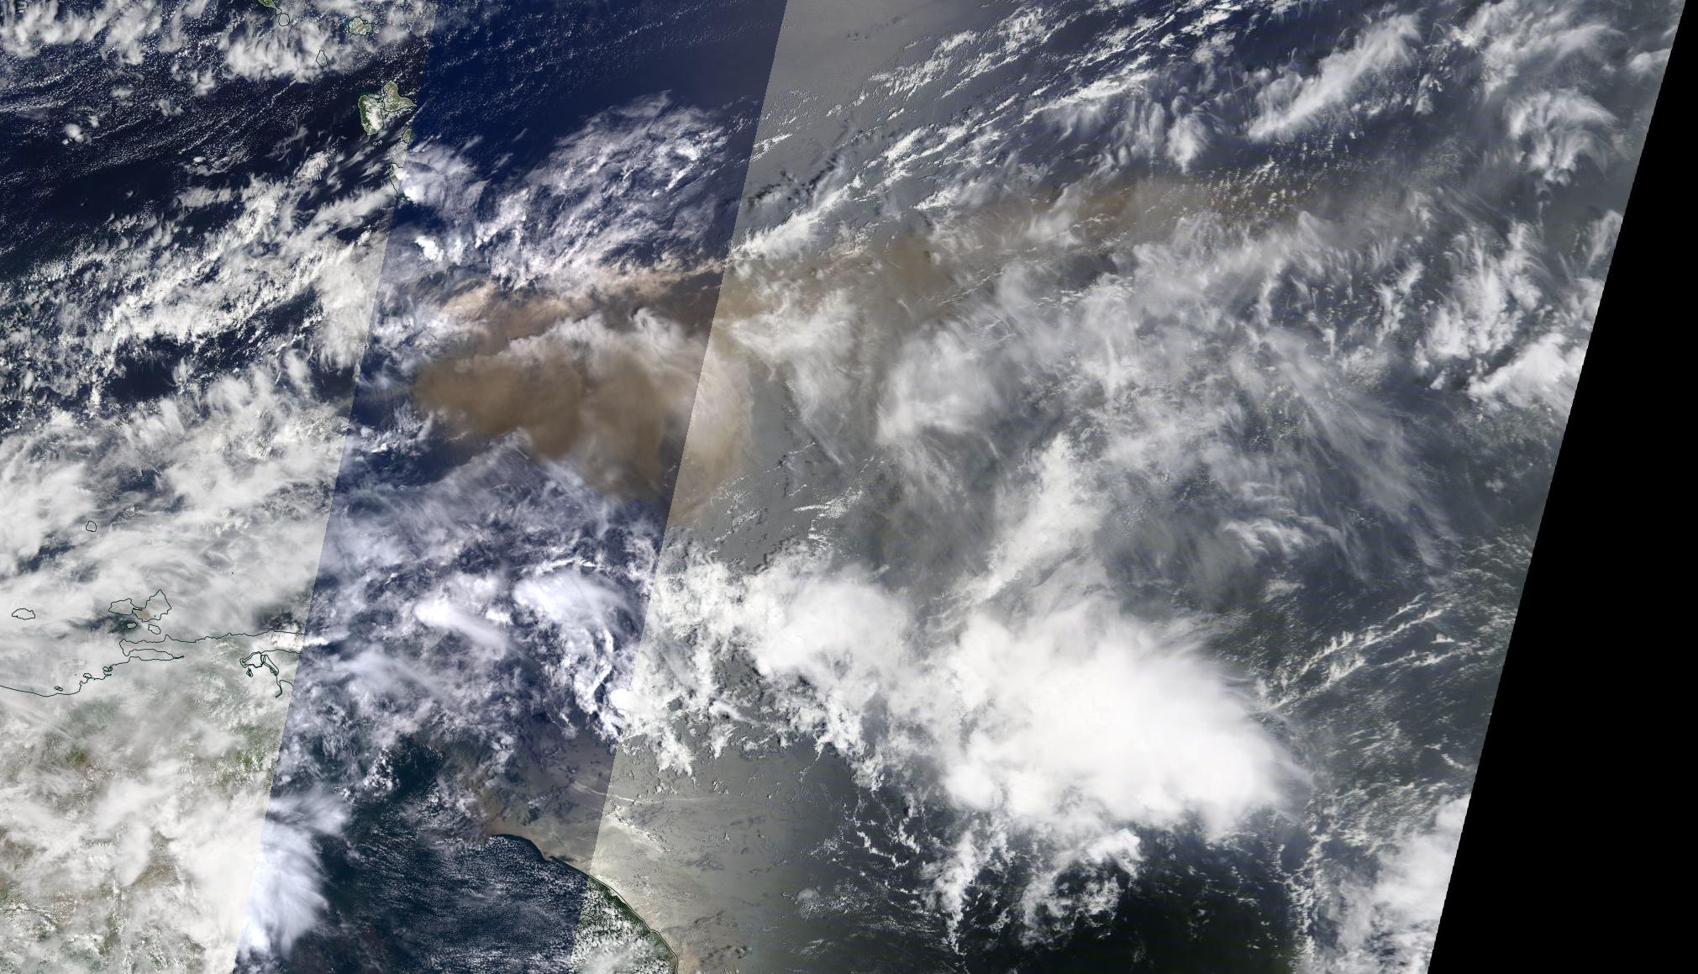
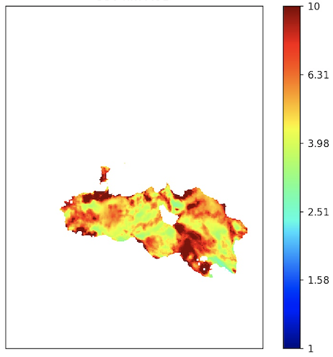
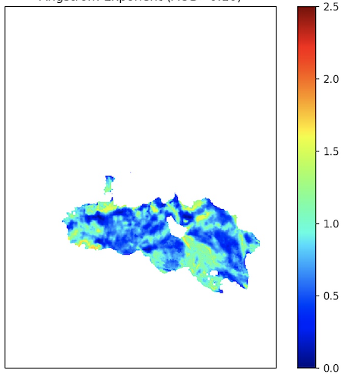
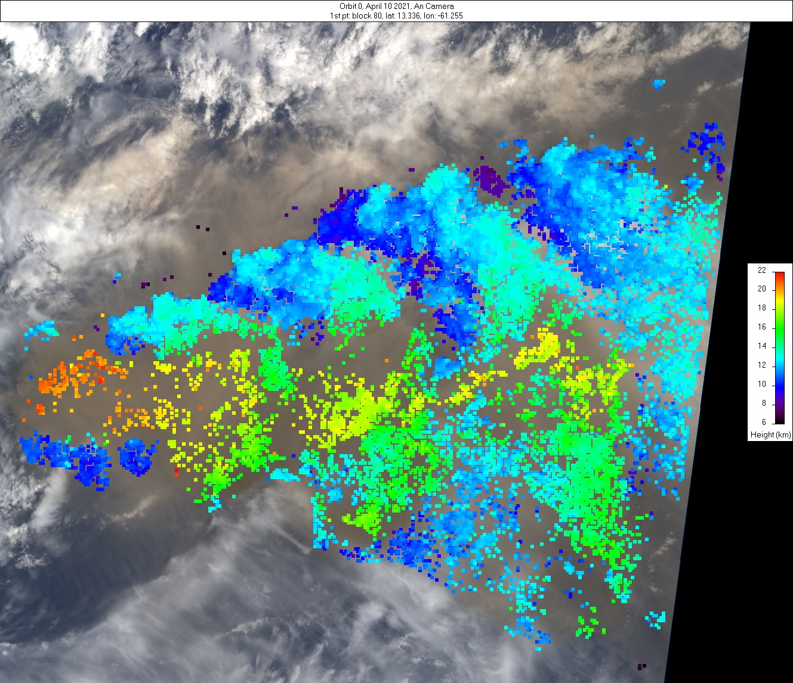
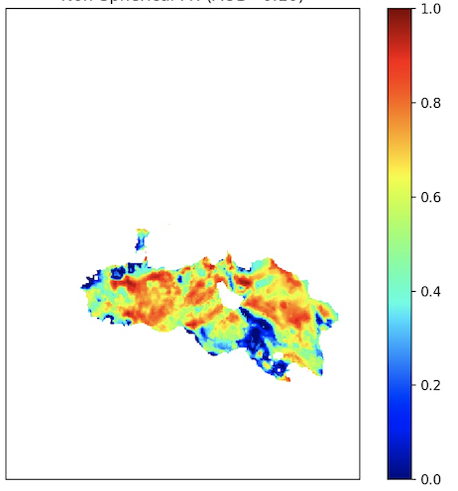
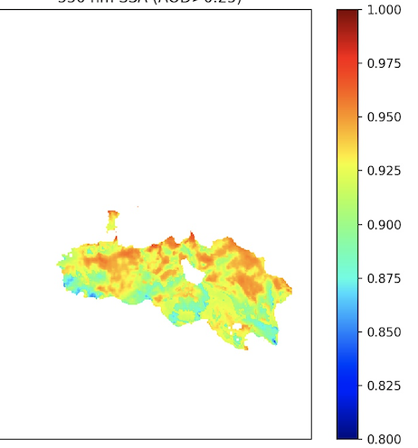
Volcanic eruption plume from La Soufriere Volcano, St. Vincent
MISR Active Aerosol Plume-Height (AAP) Project 10 April 2021
MISR Research Algorithm – Aerosol Amount and Type Retrievals
La Soufriere, St Vincent
The explosive eruption of La Soufriere volcano began on 9 April 2021. On 10 April MISR observed a large plume from the volcano, reaching an altitude of ~18-20 km at its core, with fringes transported at ~12 km. The plume was transported to the east with significant lateral spreading. Visual characteristics indicate ash components. Activity continued for at least several more days, with ongoing eruptions potentially causing regional hazards to populations and aviation.
A
B
Particle
Amount
Particle
Size
Plume region
MISR
MODIS Context Image
AOD (550 nm)
Angstrom Exp.
The plume is visible among significant meteorological cloud, with mid-visible AOD>3; Fig. A) and is dominated by large sizes (Angstrom Exp. ~0.5; Fig B).
C
Particle
Shape
D
Particle
Brightness
The plume shows evidence of non-spherical particles (fraction >0.7; Fig. C) that are light-absorbing (dark) (SSA~0.92; Fig. D). In summary, the MISR Research Aerosol (RA) retrieval algorithm indicates large, non-spherical, light-absorbing (brown) particles, an ash-rich volcanic plume.
Fr. Non-Sph.
SSA (550 nm)
MISR Plume Heights (ASL)
J. Limbacher, V. Flower, R. Kahn / NASA GSFC

Slide 20
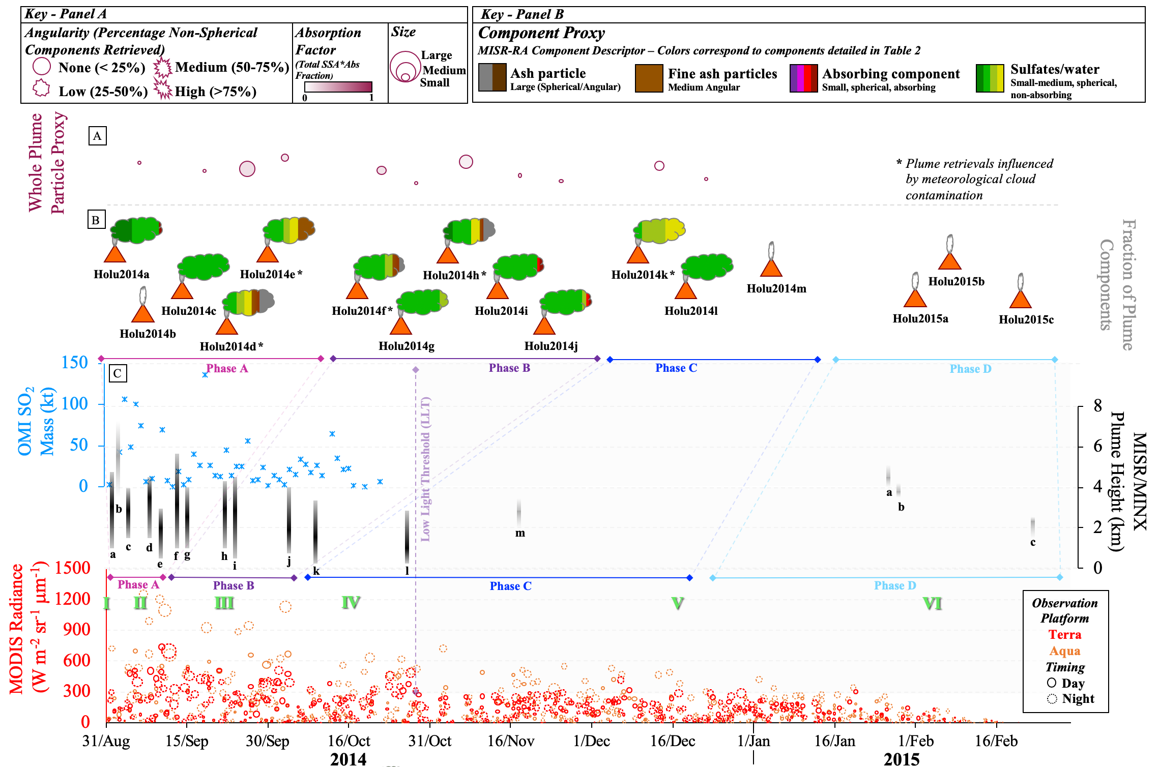
Timeline of Plume Observations – Holuhraun
Aug 2014-Feb 2015
Multi-sensor eruption assessment
Particle properties relatively constant as the eruption progressed (minor variations due to cloud contamination)
Retrievals dominated by small, spherical, non-absorbing components
As the eruption progressed there were decreases in:
plume detection and height
SO₂ emission
lava flow detection
Overall higher thermal radiance and large flow area than observed at Eyjafjallajökull
Flower & Kahn JGR., 2020
Notes:
Known to be a sulfate

Slide 21
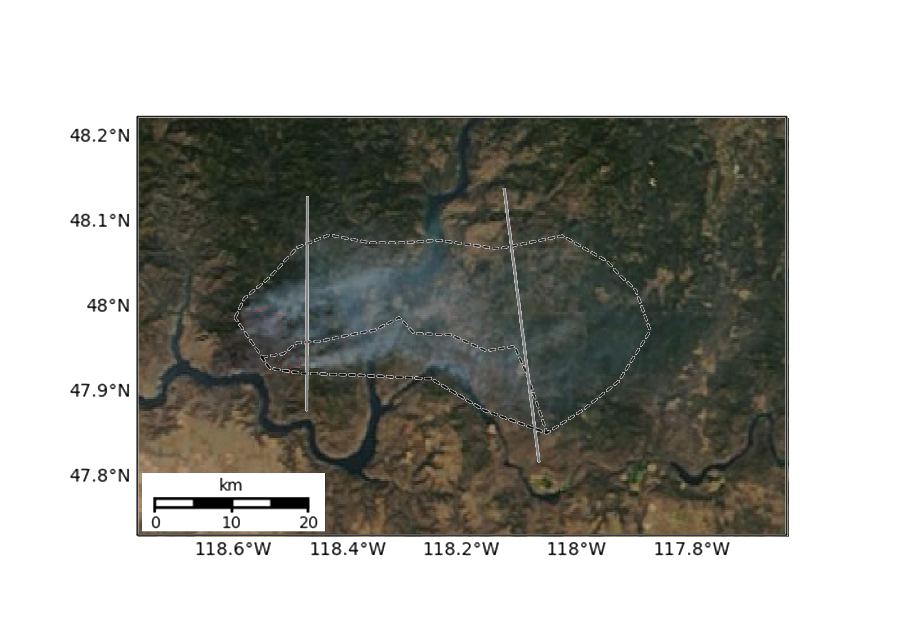
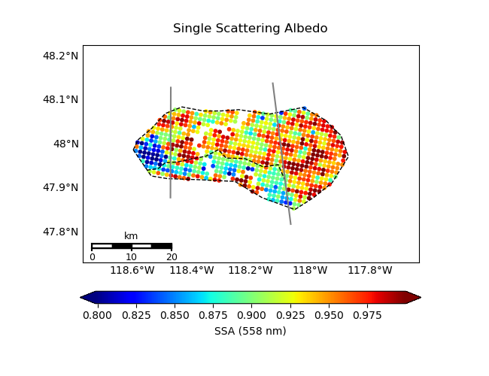
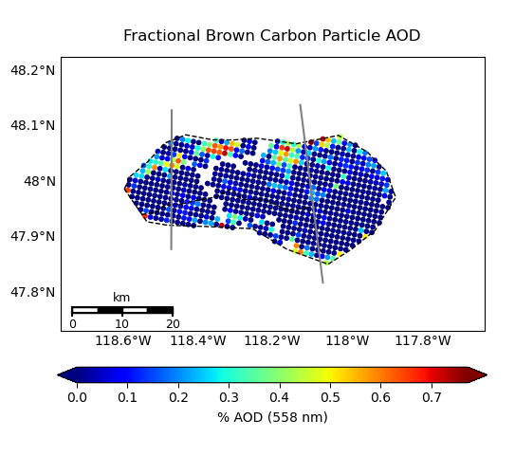
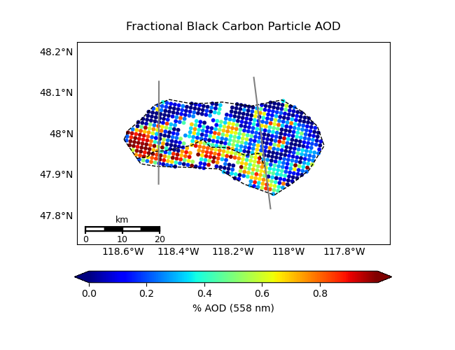
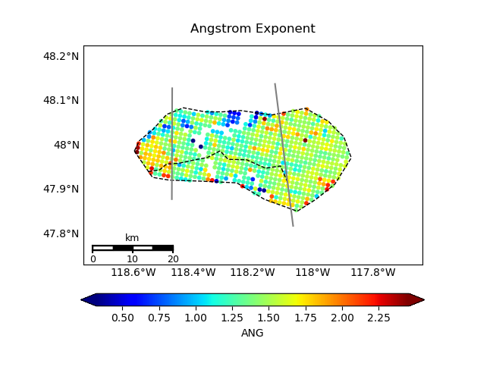
Williams Flats Fire Complex, Washington
06 August 2019 (FIREX-AQ Campaign)
From Particle Type, can infer:
Processes & Timescales
~33 mins aged
~140 mins aged
~200 mins aged
SSA ~ particle brightness
• Oxidation progressively along plume
• Region II: Coagulation or hydration
• Region III: Gravitational settling
• Region IV: More BC from SW fire
• Validated w/FIREX in situ data
• Can now use MISR data globally,
where field data are lacking
II
I
III
IV
Terra/MODIS 19:07 UTC
Brown Smoke AOD Fraction
Black Smoke AOD Fraction
ANG ~ 1/particle size
Junghenn-Noyes, Kahn, et al. 2020

Slide 22
Backup Slides

Slide 23
Variables of Interest will depend on the composition and elevation of the eruption plume…
TEMPO Variables Likely of Use
Aerosol: AOD, AAOD, UV-AI
Plume Height: UV-B
Related Volcanic Gases: SO₂, H₂O
Related Wildfire Gases: H₂C=O (Formaldehyde);
possibly C₂H₂O₂ (Glyoxal)
Other Space-based Resources Likely to Contribute
Fire, Volcano Hotspots: MODIS/VIIRS 4-micron thermal anomaly
Aerosol Particle Size, Shape (ash/sulfate): MISR; PACE HARP-2
Plume Extent; Height; Particle Properties: GOES ABIs

Slide 24
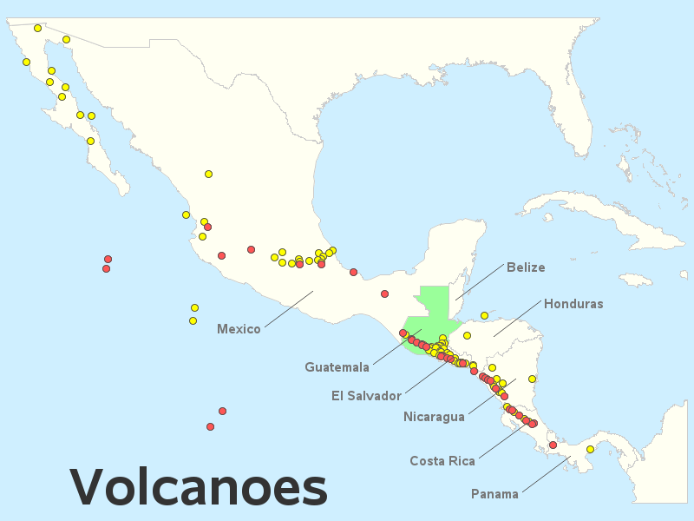
Green Paper – Central American Volcanic Plumes:
TEMPO High-Temporal-Resolution Aerosol & Gas Observations
Ralph Kahn¹, Verity Flower², James Limbacher³, Kathleen McKee⁴, Katherine Noyes¹, Aaron Naeger⁵
¹NASA Goddard Space Flight Center, ²U. of Stirling, ³NOAA, ⁴Vanderbilt U., ⁵U. Alabama Huntsville
Note: Pixel resolution becomes higher toward the equator
17.5°N
15.5°N
Eruption Observed
Eruption Credible
Can we extend the southmost scan operations even further,
to cover as many potentially active volcanoes as possible?

Slide 25
Daniel Tong
George Mason

Slide 26

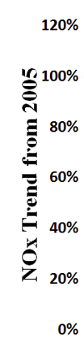
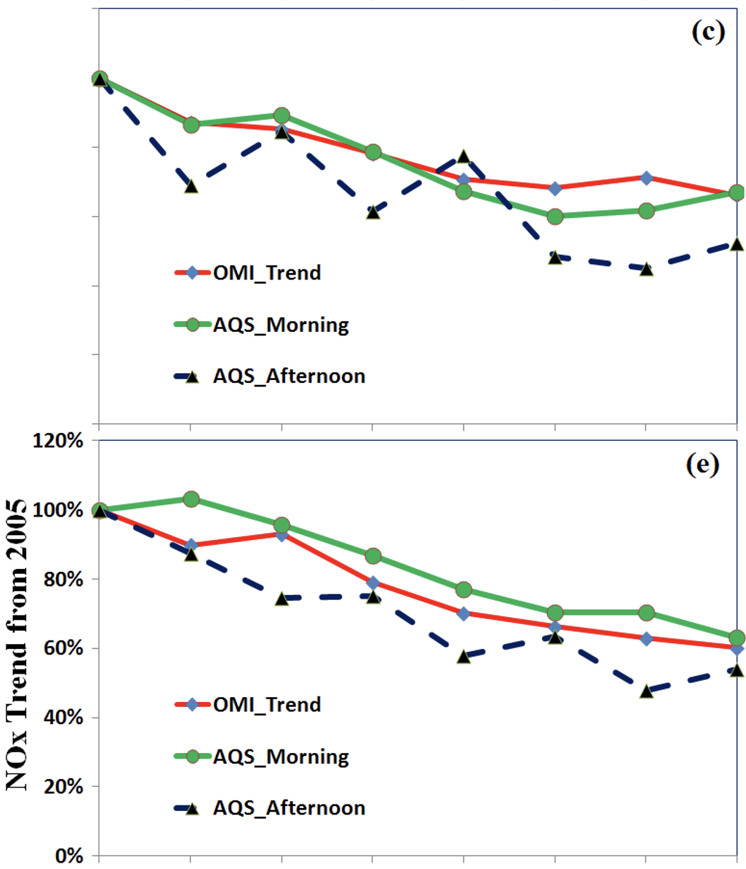
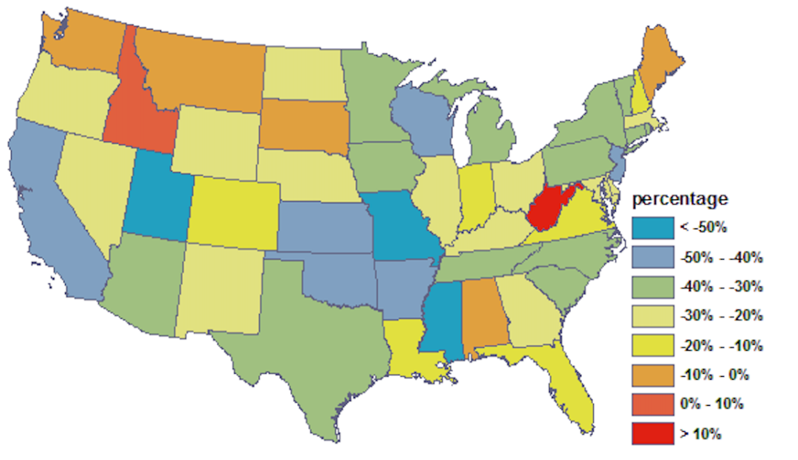
NOx Rapid Emission Refresh
Daniel Tong, George Mason University
Rapid Refresh of NOx Emissions : Fusing satellite and ground data to adjust NOx emissions
- Fusing AQS & OMI (Tong et al., 2016)
- Morning vs Afternoon NOx
ΔS and N_{S} - changing rate and data number of satellite data;
ΔG and N_{G} -- rate and number of ground data;
f_{S} and f_{G} -- weighting factors for satellite and ground data;
- State-level Projection Factors

Slide 27
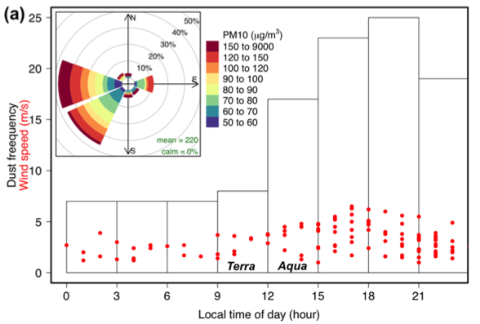
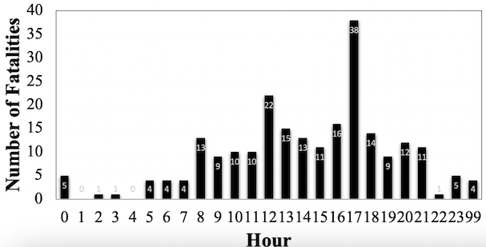
Detection of Dust Hotspots and Dust Storms
Daniel Tong, George Mason University
Dust storms in America peak a few hours before sunset, so are their damages
Diurnal Variations of Dust Storms
Fatalities from Dust-Caused Crashes
Dust Frequency
Local Time
(Huang et al., 2015)
(Tong et al., 2023)
Much needed new dust detection capability

Slide 28
Fangjun Li
South Dakota State

Slide 29
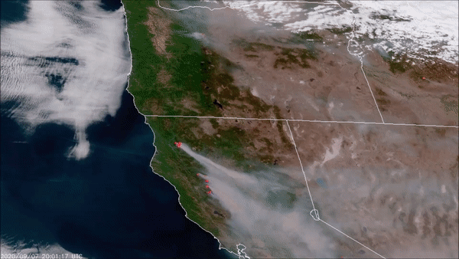
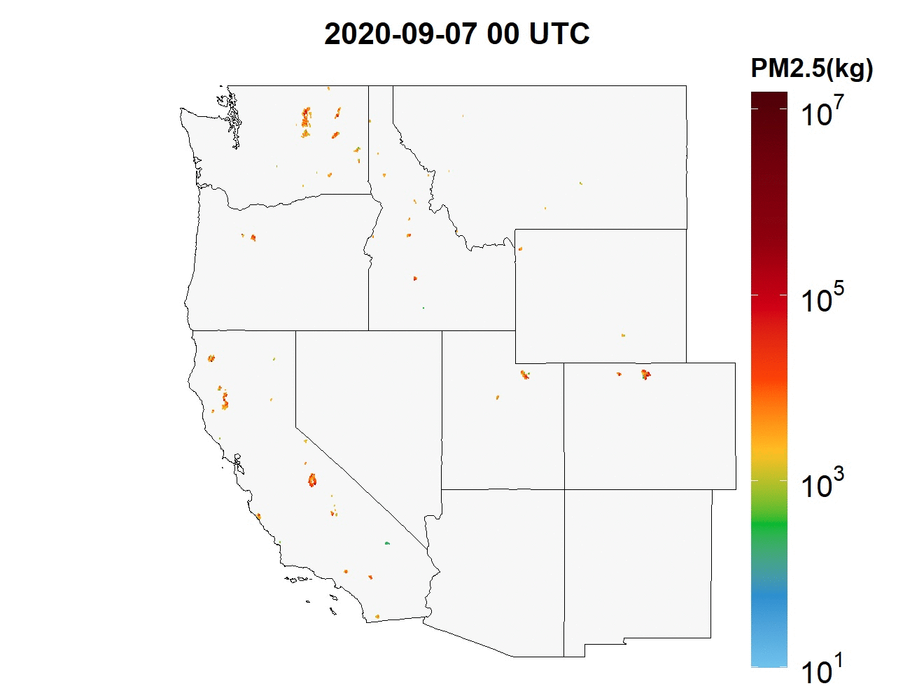
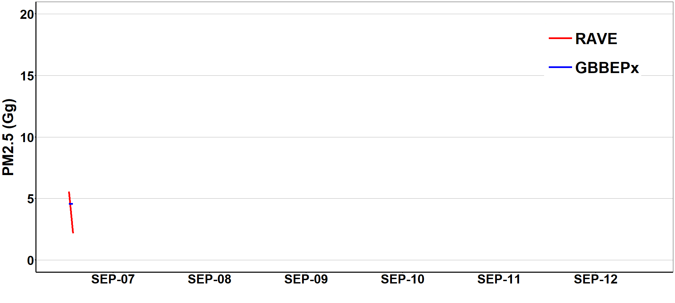
Regional ABI and VIIRS based fire Emissions (RAVE)
Hourly fire emissions by fusing GOES-R ABI and VIIRS fire radiative power (FRP)
RAVE product provides hourly 3km emissions for 11 species (CO2, CO, PM_{2.5}, BC, OC, SO₂, NO_{x}, NH₃, VOCs, TPM, and CH₄)
Operational RAVE product supports several NOAA air quality forecast models.
Li, F., X. Zhang, S. Kondragunta, X. Lu, I. Csiszar, and C. Schmidt, Hourly biomass burning emissions product from blended geostationary and polar-orbiting satellites for air quality forecasting applications, RSE, 2022

Slide 30
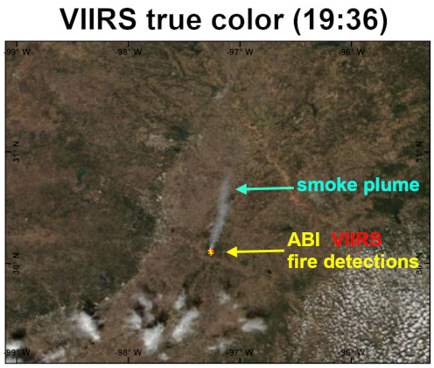
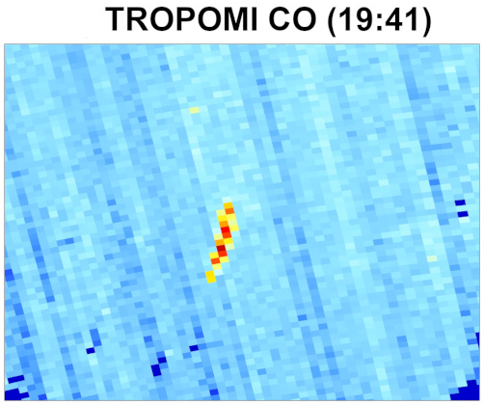
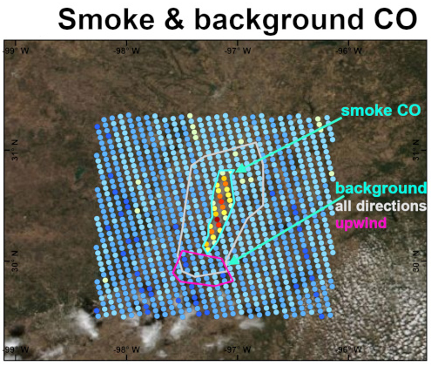
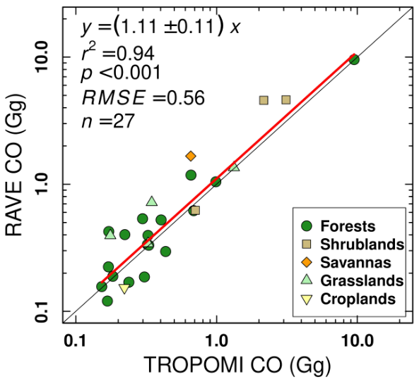
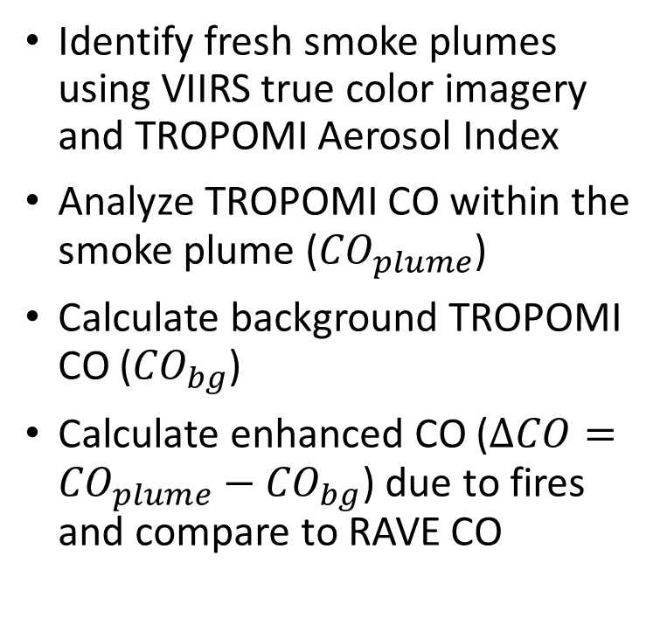
RAVE Emissions Evaluated using TROPOMI CO
Identify fresh smoke plumes using VIIRS true color imagery and TROPOMI Aerosol Index
Analyze TROPOMI CO within the smoke plume (${CO}_{plume}$)
Calculate background TROPOMI CO (${CO}_{bg}$)
Calculate enhanced CO ($∆CO={CO}_{plume}−{CO}_{bg}$) due to fires and compare to RAVE CO
Li, F., X. Zhang, S. Kondragunta, X. Lu, I. Csiszar, and C. Schmidt, Hourly biomass burning emissions product from blended geostationary and polar-orbiting satellites for air quality forecasting applications, RSE, 2022

Slide 31
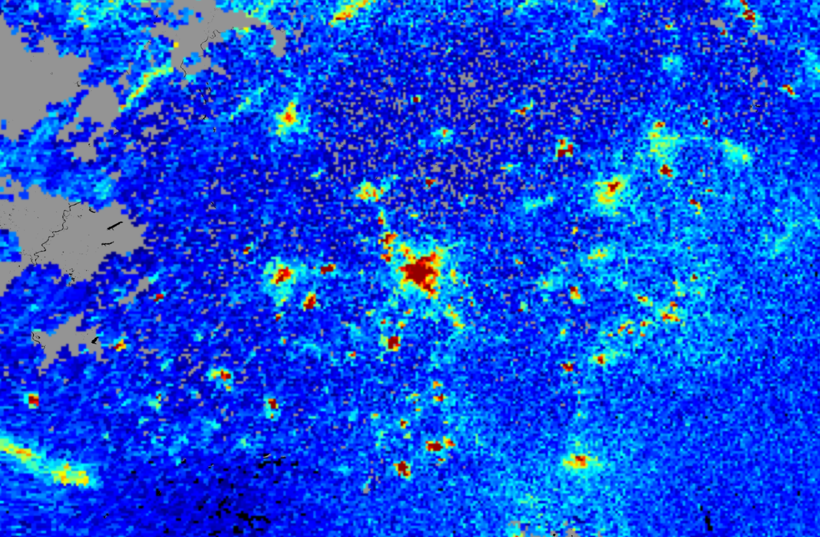
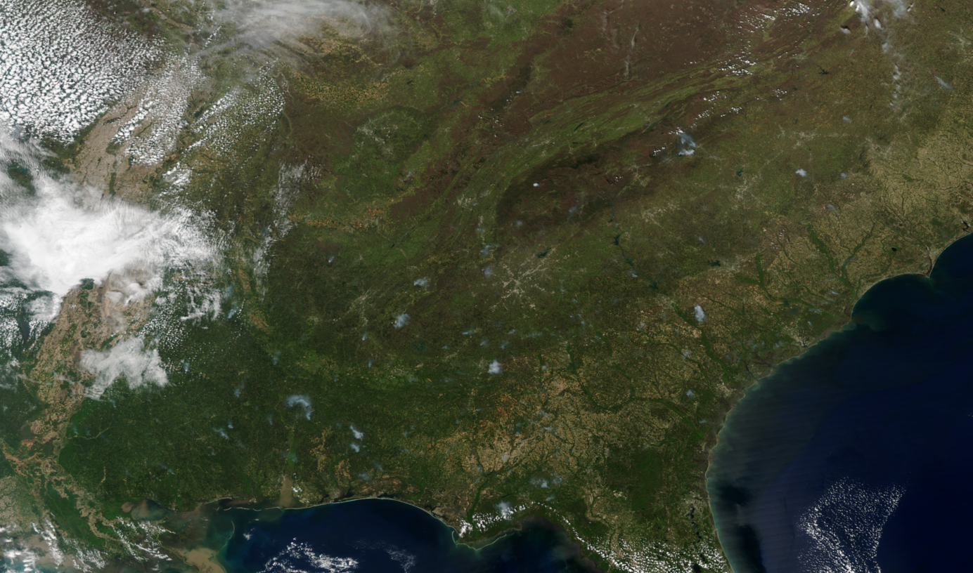

Opportunities: Hourly TEMPO NO₂
TROPOMI NO₂
Suomi NPP VIIRS
April 5th, 2021
2:30 PM
2:25 PM
Apply hourly TEMPO NO₂ observations to evaluate daytime hourly RAVE NO_{x} emissions in a similar way as with TROPOMI CO observations.
Unlike CO, NO₂ is not long-lived and amount of NO₂ emitted depends on fuel type and fuel consumption.
Analysis of TROPOMI and TEMPO NO₂ data will be carried for different types of fires prior to using in RAVE validation work.

Slide 32
Barron Henderson
EPA

Slide 33
TEMPO Can Improve EPA Data Products
TEMPO can:
Help address the temporal and spatial variations of emissions of gases and aerosols.
Help elucidate the physical, chemical, and dynamical processes drive tropospheric composition changes over a variety of temporal scales.
Help identify episodic events.
Yes, but how can this information be fed into the work of the Agency and improve EPA data products?

Slide 34
EPA’s Emissions Overview
Emission
Methods &
Emission
Factors
The National Emissions Inventory
Houses annual, source-specific emissions of CAPs, CAP-precursors, and HAPs. Some emissions are more finely resolved (fires).
SPECIATE and S2S-Tool
Database and tool, respectively, that translates source-specific explicit profiles to chemical mechanism-specific profiles (VOC and PM_{2.5}).
SMOKE
Generate gridded, speciated photochemical modeling files, often at hourly resolution.
The easiest way to incorporate data products into our processes is to provide them in a manner that fits our existing tools and needs.
SPECIATE
VOC
NO_{x}
Etc.
Speciation Profiles
NEI
Explicit Compound Profiles
S2S-Tool
Mechanism-Specific Profiles
Emissions
per SCC
Modeling Profiles
Additional
SMOKE
Input
SMOKE
CMAQ
GEOS-Chem
Speciated Emissions
PM_{2.5}/O₃

Slide 35
Diurnal Emissions in EPA Modeling Platforms
Some sectors employ highly technical models to temporally allocate emissions: Onroad mobile, wild and prescribed fires.
Other sectors are on-line modules within CMAQ and influenced by location specific meteorology: biogenics, fertilizer NH₃.
Most have monthly, day-of-week, and hourly profiles applied within SMOKE.
If TEMPO can be leveraged to elucidate monthly, day-of-week, hourly, or even episodic emissions from discrete sources/sectors, this information can directly feed into EPA’s data products.
If there is a physical, chemical, and dynamical processes that drives emissions intensity, we can use that information.
If the temporal profile of emissions change by location (e.g., county-specific), we can use that information.

Slide 36
Example of Oil and Gas Emissions
Temporal allocation is Source Classification Code and county-specific for annual-to-monthly profiles.
221 individual SCCs; range from on-/off-shore oil/gas exploration/production, including flares, wells, pumps, separators, tanks, and more.
2.7 million tons of VOC (does not include methane/ethane).
All day-of-week and diurnal profiles are flat.
Key challenge: how to account for super emission events?
Can data from TEMPO be used to generate diurnal profiles from select processes at the county- or basin-scale?
Can diurnal profiles that reflect real world conditions/emissions be extracted?

